Slide 1
Exam Score Prediction
Ivan Yau

Slide 2
The Study
This study explores whether lifestyle habits significantly influence students' academic performance. By analyzing factors such as age, gender, study hours, social media usage, Netflix hours, part-time employment, attendance percentage, sleep duration, diet quality, exercise frequency, parental education level, internet quality, mental health rating, and extracurricular participation, the study examines their impact on exam scores.

Slide 3
Motivation
As a student myself, I am particularly intrigued by the question of what factors shape academic success. Gaining insights into how different habits affect performance is both academically interesting and personally valuable for my educational journey.

Slide 4
Importance
Understanding the connection between lifestyle habits and academic performance can guide the development of more effective student support strategies. A related study found that 71.42% of students with GPAs of 18 or higher had good lifestyles, whereas over 55% of students with GPAs below 14 exhibited poor lifestyles [1]. This highlights the strong link between healthy habits and academic achievement. Just as predictive models in medicine help identify at-risk individuals, educational institutions can use data-driven insights to proactively support students exhibiting poor lifestyle habits.

Slide 5
Approach and Evaluation
This project focuses on predicting students' academic performance using lifestyle-related features. Several machine learning models, including Linear Regression, Random Forest, XGBoost, Support Vector Regression (SVR), and Multi-Layer Perceptron (MLP), were implemented and evaluated. The performance of each model was compared using appropriate metrics, and the evaluation focused on identifying why certain models outperform others. Multiple feature sets, including original features, interaction terms, and refined subsets based on feature importance, were tested to optimize model performance. Cross-validation was used to fine-tune hyperparameters and avoid overfitting. Evaluation metrics like precision and recall were prioritized, as they provide a more targeted assessment of model effectiveness in high-stakes academic prediction.

Slide 6
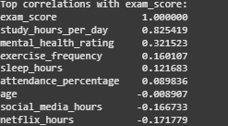
Exploratory Data Analysis
No missing data was found.
Descriptive statistics revealed that the average exam score was 69.6 with moderate variability. Students studied an average of 6.47 hours per day and spent about 4.3 hours on leisure activities. These variations in study and leisure time suggest that lifestyle habits may significantly impact academic performance.
The correlation matrix revealed that study hours per day had a strong positive correlation (0.83) with exam scores, suggesting that more study time leads to better performance. Factors like mental health rating (0.32), exercise frequency (0.16), and sleep hours (0.12) showed weaker positive correlations. Interestingly, social media hours (-0.17) and Netflix hours (-0.17) displayed weak negative correlations, suggesting that more time spent on these activities slightly decreases exam scores. Age showed no correlation (-0.01) with performance.

Slide 7
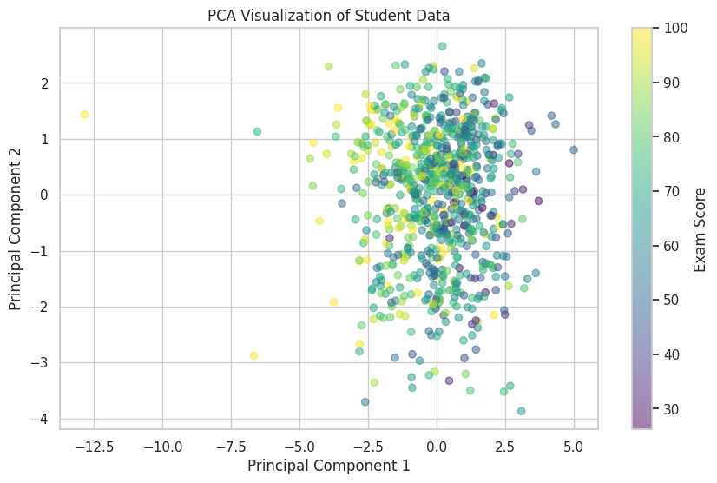
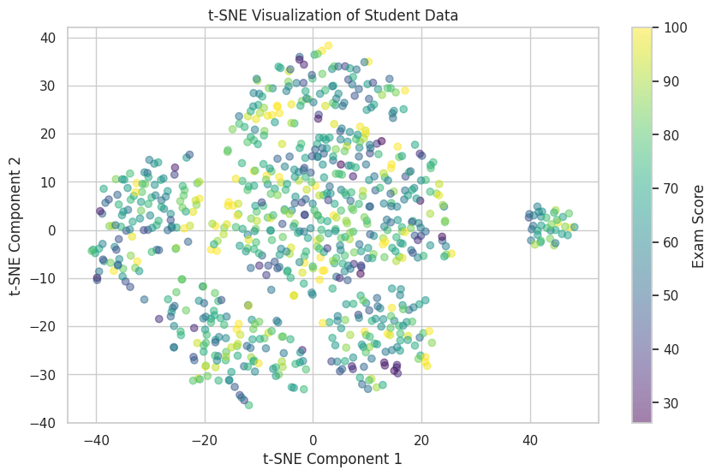
Data Overview and Preprocessing
To improve model performance, two new features were engineered: total leisure hours and productivity ratio. Categorical data was one-hot encoded, and all features were standardized using StandardScaler to ensure optimal model performance.
Dimensionality reduction using PCA showed tightly clustered data with no clear score-based separation, while t-SNE revealed distinct clusters, suggesting meaningful behavioral groupings among students.

Slide 8
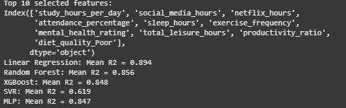
Model Analysis
The dataset was split into training and test sets (80/20 ratio) to assess model generalization. Feature selection was conducted using SelectKBest with an f_regression score function to identify the top 10 features most predictive of student performance. These included features related to study habits, screen time, attendance, sleep, and health.
Among the models evaluated using 5-fold cross-validation, Linear Regression achieved the highest mean R² score of 0.894, indicating a strong linear relationship between the features and exam scores. Random Forest (R² = 0.856) and XGBoost (R² = 0.848) also performed well but were slightly less effective than the simpler linear model. More complex models like SVR and MLP showed lower performance.

Slide 9

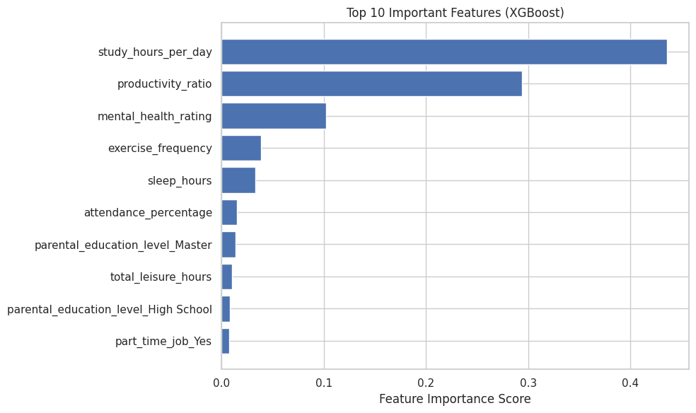
Results
GridSearchCV with 5-fold cross-validation was used to fine-tune model hyperparameters. For Random Forest, parameters like number of trees, tree depth, and split criteria were adjusted. For XGBoost, key tuning included tree depth, learning rate, and number of estimators. This helped boost performance and prevent overfitting.
On the unseen test set, both tuned models performed well. Random Forest achieved an R² of 0.854 and RMSE of 6.12, while XGBoost slightly outperformed it with an R² of 0.866 and RMSE of 5.86. These results indicate strong generalization and accurate prediction of student scores.
Feature importance analysis revealed that study hours per day (importance: 0.45) was the strongest predictor of academic performance, followed by productivity ratio (0.285) and mental health rating (> 0.1). Factors like social media and Netflix hours had lower but still relevant impact on model predictions.

Slide 10
Conclusion
This study demonstrates that lifestyle habits, particularly study time, productivity balance, and mental health, play a significant role in predicting students' academic performance. By leveraging machine learning models such as XGBoost and Random Forest, we were able to identify and quantify the impact of these factors on exam outcomes. The analysis suggests that students who manage their study time effectively, limit excessive leisure activities, and maintain good mental health are more likely to succeed academically.

